Slide 1

Slider Puzzle
Android Development Tutorial
Carlton Duffett Boston University Computer Engineering 2016

Slide 2
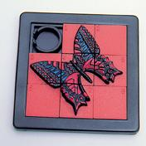
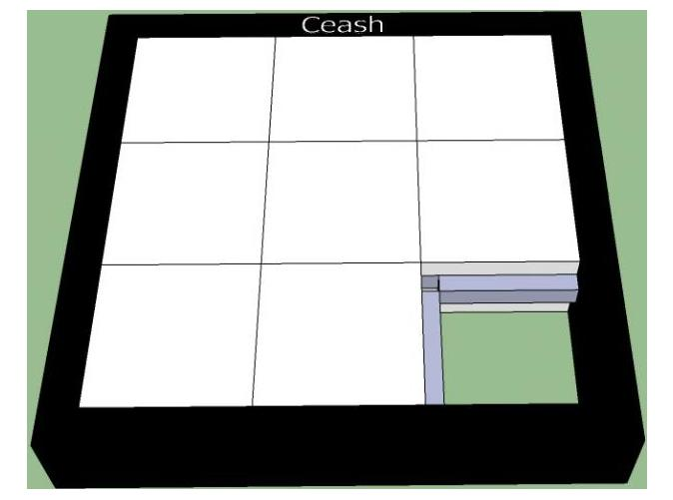
Introduction:
Android –most widely-used app software on the market!
Open Source – that means FREE
Many popular applications are games – often adapted from puzzles and toys that exist outside of computer
Slider puzzles:
Notes:
Android is all open-source software. The best part about open-source software? It’s FREE!

Slide 3
The Slider Puzzle Game:
Problem: - 9 squares and 8 tiles; only one free space - All of the tiles are shuffled out of order How to Play: - Move a tile right, left, up, or down into a free space - Can only move one tile at a time Goal: - Get all of the tiles back in sorted order Bonus: do it in as few moves as possible!

Slide 4
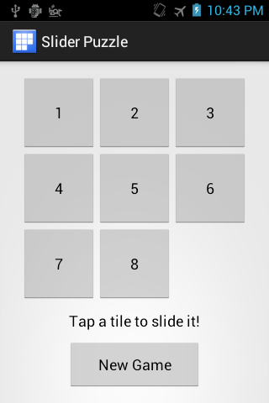
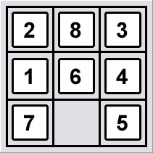
Our Goal:
Notes:
We want to transform the slider puzzle we can hold in our hand… into an app we can use on our mobile phone!

Slide 5

The Development Environment:
Eclipse Integrated Development Environment (IDE)
Android Development Kit (ADK)
Programming languages:
Java – used to write the
behavior of the app
XML – used to write the
layout of app
ADK
Notes:
There is special software that you have to use to develop apps. Android relies on two programming languages – Java and XML.

Slide 6
The Roles:
Interface Designer
Responsible for the layout of the app and everything the user actually touches.
Without the interface, there is no way for the user to interact with the app!
Back-End Designer
Responsible for the behavior of the app.
Without the back-end, whenever the user clicked on something, nothing would happen!
The two must work together for everything to work!
Notes:
Importance of teamwork in app development – no professional app out there gets developed alone!

Slide 7


An Analogy:
Back-End
Interface
Notes:
Interface – smooth, sleek, visually appealing; looks fast! But…
Back End – the engine, the raw power that drives the beautiful interface of the app!

Slide 8
The Interface Designer
The layout and visual appearance

Slide 9
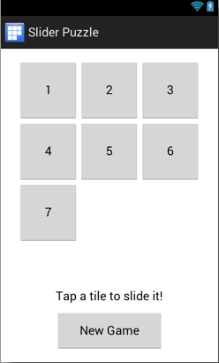
The Interface:
What’s missing?
We still need to add the last
tile to the puzzle!
How?
Notes:
We start with the interface almost complete – just need to add the last button.
This part of the tutorial will be an example of how you can add elements to your screen.
The method used here can be extended to other elements in a similar way!

Slide 10
Adding a Button to the App:
Using the Graphical Layout Tool
Visual tool to add elements to the screen
Automatically adds the code to the activity_main.xml file
activity_main.xml
Code that defines the layout of the “Main Activity”
Main Activity is the first screen the user interacts with
Every Android app has a Main Activity that it brings up when the user first starts the app!

Slide 11
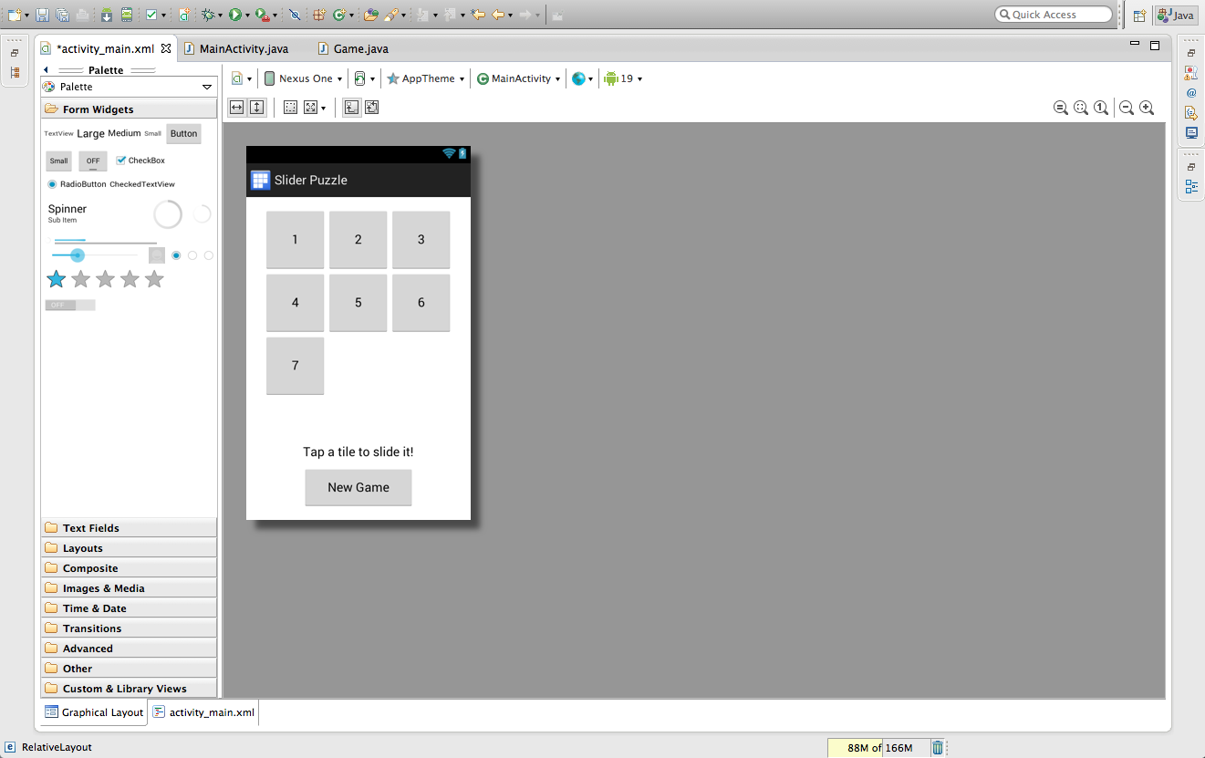
activity_main.xml
Graphical Layout
Notes:
Click on the activity_main.xm tab at the top-left. Then click on the “Graphical Layout” tab to get to the Graphical Layout Tool.

Slide 12
Drag a button into your app!
Notes:
Drag the last button (button 8) into its place on the screen. Try to get it as close to its actual position as possible.
Look for a dashed, vertical green line in the center of the screen to tell you that your button is centered.
Also look for a solid green line and an arrow between the bottom of your button and button7. This will align their bottoms.
Button 9 is already present but it is invisible and will not be noticeable to any of the students.

Slide 13
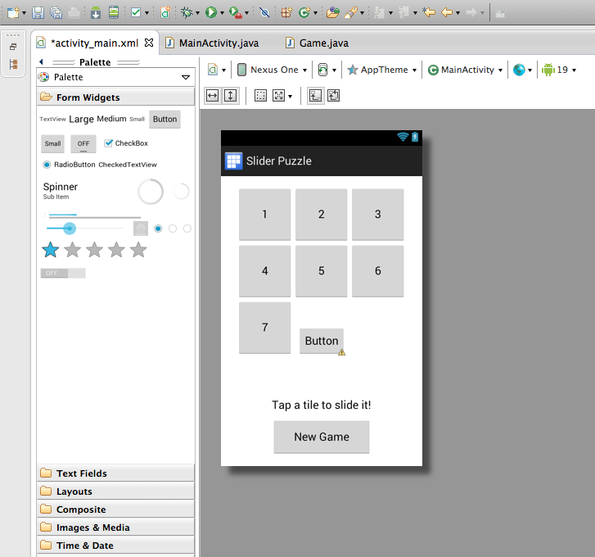

Now we have a button, but…
We’re not
done yet!
Notes:
Notice that there is a warning sign! Android is trying to tell us that we’re not done setting up the button yet.

Slide 14
Customizing Our Button:
Want to make the button look like the other tiles
What do we need to do?
Make it square!
Add the number 8 to it!
Align it with the other tiles!
That’s where the .xml code comes in!
Bottom-left of Screen
Notes:
To finish setting up the button we need to work with the actual XML code – switch to the activity_main.xml code by clicking on the “activity_main.xml” tab next to the “Graphical Layout” tab in the bottom left of the screen.

Slide 15
Working with the XML Code:
XML is a language that the computer reads.
By reading the XML code, the computer knows where to put your buttons on the screen.
Scroll down to the the button you created…

Slide 16
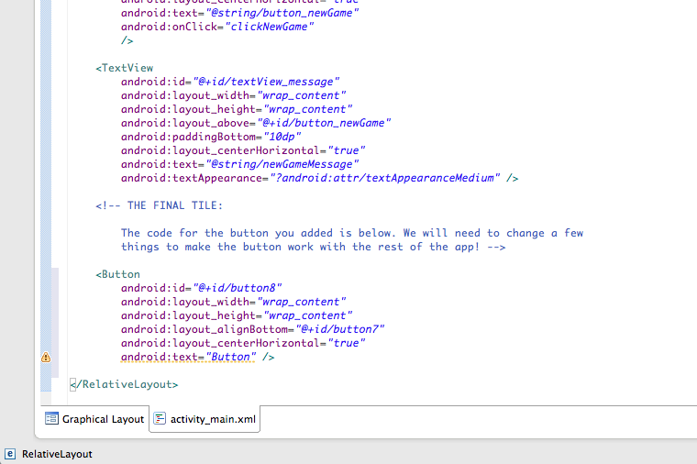
The code for your button

Slide 17
Making the Button Square:
<Button
android:id="@+id/button8"
android:layout_width="wrap_content"
android:layout_height="wrap_content"
android:layout_alignBottom="@+id/button7"
android:layout_centerHorizontal="true"
android:text="Button" />
Change to “90dp”
<Button
android:id="@+id/button8"
android:layout_width=“90dp"
android:layout_height=”90dp"
android:layout_alignBottom="@+id/button7"
android:layout_centerHorizontal="true"
android:text="Button" />
Notes:
To make the button square, we will need to change its width and height. Since all sides of a square are the same length, we will need to set the width and the height to the same value. All other tiles have a width of 90dp and a height of 90dp. We will give this last button the same dimensions.

Slide 18
Adding the Number 8:
<Button
android:id="@+id/button8"
android:layout_width=”90dp"
android:layout_height=”90dp"
android:layout_alignBottom="@+id/button7"
android:layout_centerHorizontal="true"
android:text="Button" />
By default, Android set the text of the button to
“Button” so you knew what it was.
Change this to the number of the button (8)!
Notes:
Simple delete the text between the parentheses (“Button”) and change it to “8” instead. Easy, right? Rmemeber quotation marks

Slide 19
Aligning with the Other Tiles:
<Button
android:id="@+id/button8"
android:layout_width=”90dp"
android:layout_height=”90dp"
android:layout_alignBottom="@+id/button7"
android:layout_centerHorizontal="true"
android:text="8" />
We want the button to be centered horizontally in the screen
and to be aligned with button7. If you don’t see these two lines
in your code, or you see other “_align” types, change them to
these!
Notes:
Some students will get “lucky” and have these alignments by default. It all depends on where you put your button in the screen when you drag it in. (see the notes for the “Drag a button into your app!” slide. If not, these are easy to change.

Slide 20
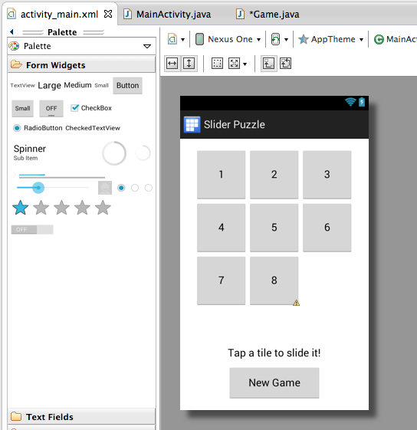
Check Your Work:
Go back to the “Graphical Layout” tab to see how the button looks now!

Slide 21
Don’t Forget to Save!
It’s important to save your work after you change each file in your app.
Click the “save” button in the top left corner before you continue.
Save
Notes:
The save icon will become inactive once you have saved your program. The asterisk next to the “activity_main.xml” tab will also go away, indicating that there are no new changes in the file since it was saved last.

Slide 22
That’s It!
Now the layout of the app is complete.
But…
We need to connect the button to the code!
This will require working with the MainActivity.java file
Switch to MainActivity.java:
Click on this tab in
the top-left
Notes:
To update the changes in the project, you must save your code after changing a file. Just click the save icon in the top left or press ‘ctrl-S’.

Slide 23
Main Activity
Connects the interface to the back-end.
Must know about all elements (buttons, images, etc.) in the interface.
Maintains a list of all of your slider tiles so the game can keep track of them!

Slide 24
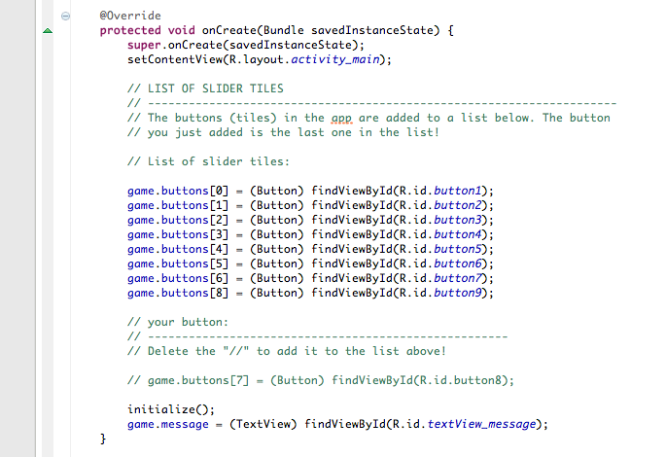
Add Your New Button to the List:
Add it to the
list of tiles!
Notes:
Deleting the “//” uncomments the line and effectively adds button8 to the list of other buttons in the app.

Slide 25
Add Actions to the Buttons:
Each time you click on a button it should do something.
This is called an “action”
You will need to add actions to the “New Game” button and the slider tiles.
The two actions you have available are called:
clickNewGame()
clickSliderTile()

Slide 26
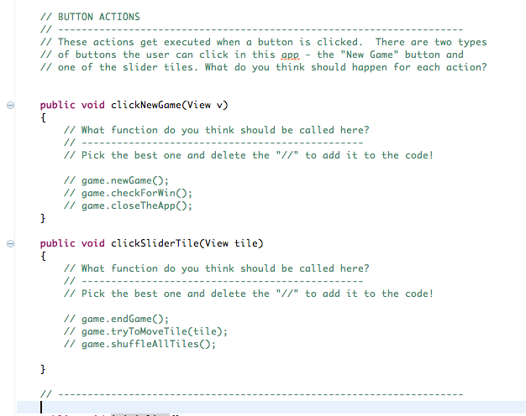
Choose the correct
action for each button!
Notes:
Students will chose between one of three actions that can be executed when each button is clicked. Some of these actually exist, some don’t. The right answer should be fairly obvious with a little coaxing.

Slide 27
The Last Interface Step:
We need to tell our new button what action to do when it is clicked.
Go back to the activity_main.xml file
Go back to the “activity_main.xml” tab to return to the code we were working with earlier:

Slide 28
Connecting Your Button:
<Button
android:id="@+id/button8"
android:layout_width="90dp"
android:layout_height="90dp"
android:layout_alignBottom="@+id/button7"
android:layout_centerHorizontal="true"
android:text="8"
android:onClick="clickSliderTile" />
Add your action here!

Slide 29
Let’s Test It!
After all that hard work, your interface is ready to test.
Press the “Run” button at the top of the screen and try your app out on the phone.
Nothing happens… the back-end isn’t done yet!
DON’T UNPLUG THE PHONE
Click to run
Notes:
IMPORTANT: There’s a little quirk with the Eclipse development environment – you need to be actively working with a .java file to run the app … no idea why.
If you don’t have a physical device, Android will try to open an emulator – this is miserably slow and really frustrating to work with – just don’t use it!

Slide 30
The Back-End Designer
The behavior and actions

Slide 31
The Game:
To make the back-end work, we need to write the code for the slider puzzle game.
This code is in sections – each section accomplishes a specific action. For example:
Start a new game
Move a tile
This involves the last file for the app – Game.java

Slide 32
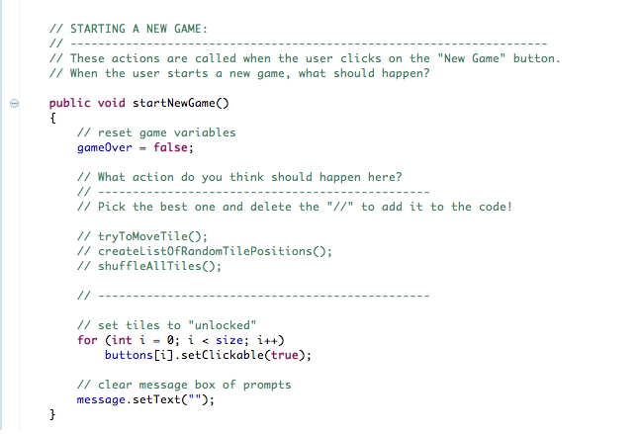
Starting a New Game:
Pick the best action

Slide 33
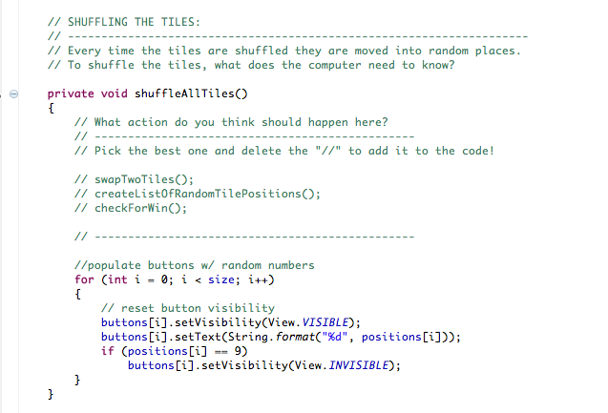
Shuffling the Tiles:
Pick the best action

Slide 34
During the Game:
There are many things that need to happen each time the player clicks on a tile.
They have to happen in the correct order for the game to work!
Some of the actions are:
Check if a tile can move
Swap to tiles if they can move
Check if the player won the game

Slide 35
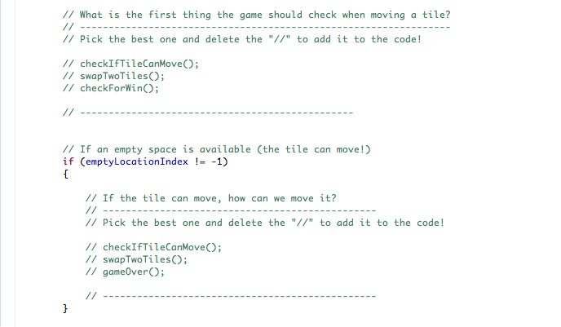
During the Game:
Pick the best actions

Slide 36

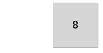
Swapping Two Tiles:
How does it work?
The empty space in the puzzle is actually an invisible tile!
When you swap two tiles, you make the new one Visible and the old one Invisible!
This happens almost instantly, but looks like motion to the eye

Slide 37
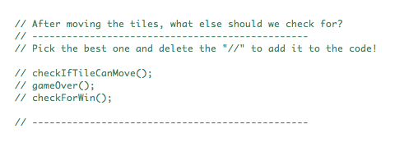
During the Game:
There’s one last thing we need to check after each move… what is it?
Pick the best action
Hint: How do we tell if the game is over or not?

Slide 38
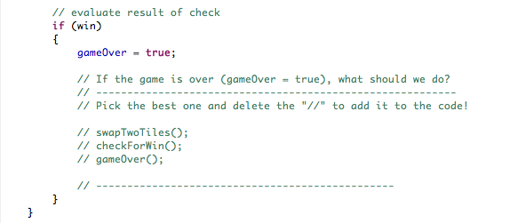
The End of the Game:
When all of the tiles are back in order, the game is over!
The app should let the player know they won and get ready for a new game.
Pick the best action

Slide 39
That’s Everything:
The Back-End and Interface are now complete.
Together, the two make a fully-functional app!
Save your work and test it out:
Save
Run!
Notes:
Again, make sure you’re actively looking at a .java file to run the app on the phone.

Slide 40


To Learn More:
For Android tutorials, check out the developer website: developer.android.com Languages: - Java - XML
Similarly tutorials available for iPhone: developer.apple.com Languages: - Objective-C

Slide 41

Free Source Code:
Complete tutorial available for download on GitHub
Includes: - Powerpoint presentation - Installation instructions for Mac and Windows - Source code - Images
https://github.com/Slider-Puzzle

Slide 42

Slider Puzzle
You can’t take the phone home with you, but…
You can download Slider Puzzle yourself on the Google Play Store
Look for Slider Puzzle’s blue and white icon!

